Slide 1
Sneak peek into x-platform game/app development
Simon Darkside Jackson
ZenithMoon Studios

Slide 2

Simon (Darkside) Jackson
Zenith Moon Studios
http://darkgenesis.zenithmoon.com
@SimonDarksideJ

Slide 3
Introduction
A world of choice?

Slide 4

vendor choice or consumer choice

Slide 5

Device platform selections

Slide 6


Slide 7
Building efficient solutions

Slide 8

What is cross platform?

Slide 9
Goals / Aims
Maximum re-use
Easy to maintain
Robust portability
Stick with managed platforms

Slide 10
Game Frameworks
Xamarin - MonoGame / SunBurn / Unity / DIY

Slide 11


Xamarin / MonoGame
Supports: iOS / MAC/ Android (plus deriv) / Windows / Windows Phone 8

Slide 12
Windows
iOS
Android

Slide 13

SunBurn gaming engine
Supports: Windows / Windows Phone / XBOX 360
Others planned

Slide 14
Code
XBOX
Phone
Windows

Slide 15

Unity
Supports: iOS / MAC/ Android (limted) / Windows / Windows Phone 8 / Web / Flash

Slide 16
iOS
WIndows
Web
Mac
Flash

Slide 17


DIY

Slide 18
Which way to turn?
Proprietary engine
Bare bones framework
Unity
SunBurn
MonoGame
Fully proprietary engine
Extensible through C# or Javascript (also Go / Boo)
Vast catalogue of paid / free assets & scripts
Hard to bespoke to platforms
Choose Engine or Platform API
Some re-work required to port
Lots of dedicated tools
Fully featured editor
Unknown x-platform costs
Code only framework
Supported by a lot of XNA tools
Minimal impact
Bespoke platform enhancements optional

Slide 19
The Costs
Lowest
Highest
SunBurn
MonoGame
Unity
Framework / Platform only – Free
Indie - $150
Pro - $300
*Other platforms unknown
Windows platforms – Free
iOS / Mac - $300-$1500 per year
Android - $300-$1500 per year
Basic edition – Free (inc Web & Windows)
iOS / Mac $300-$1500
Android - $300-$1500
Flash - $300-$1500
Win 8 / RT / WP8 ???

Slide 20
App Frameworks
Xamarin-Mono Native / PhoneGap / Appcelerator / MvvmCross - Xamarin

Slide 21
Xamarin native
Supports iOS / Mac / Android / Windows / Web
C# based framework
Skeleton framework built on top of Mono for deployment to all supported platforms
Lots of additional help and fantastic documentation resources to get started

Slide 22

PhoneGap
Supports iOS / Mac / Android / Windows / Bada / Symbian / WebOS / Blackberry
Web based framework solution
Provides high level of platform abstraction to access platform specific features, e.g. Accelerometer / Storage

Slide 23

Appcelerator
Supports iOS / Mac / Android / Blackberry / Web / *Windows
Eclipse / Javascript based framework
A different approach providing full lifecycle development
Rich cloud based backend / analytics provided

Slide 24

MvvmCross
Created by Stuart Lodge @Slodge (a dinosaur)
Full MVVM framework built on top of Mono
Rapidly improves and promotes good cross platform app development

Slide 25

Spotlight on Xamarin 2.0

Slide 26
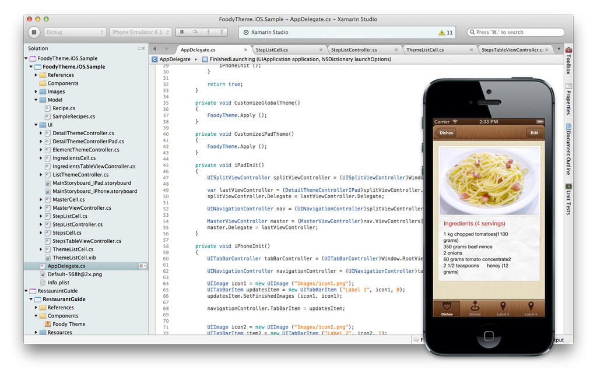
Xamarin Studio
New IDE
Supports Windows /Android / Linux projects in Windows
Supports iOS / MAC / Android / Linux / Windows on MacOS
Built on MonoDevelop
Backed by professional component library

Slide 27
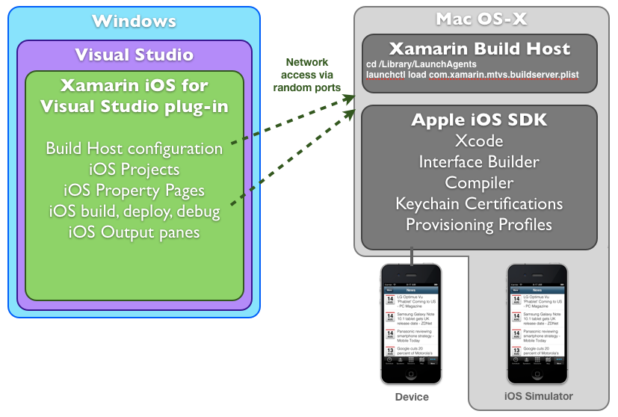
Visual Studio Extensions
Supports iOS on Windows, test through Mac / iOS host
Supports Android on Windows inc emulator through Android SDK
Upcoming support for Win 8 / RT / WP8
Enterprise level and above ONLY

Slide 28
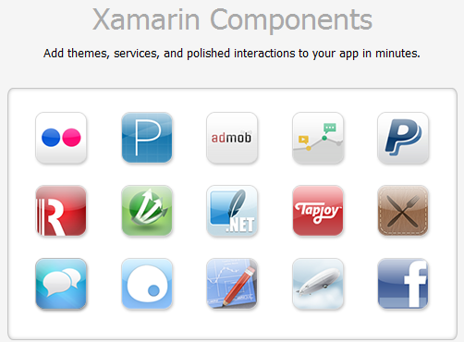

Slide 29
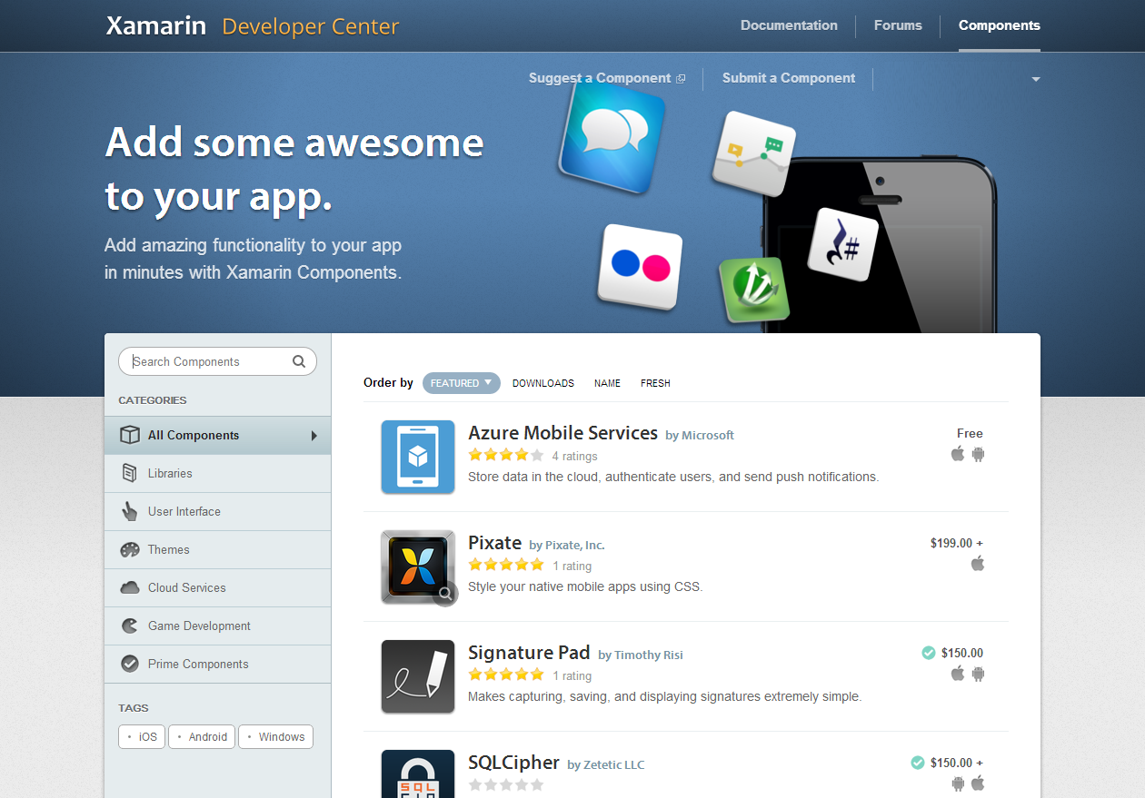
Xamarin Components via web
56 readily available components already
Library is continually growing

Slide 30
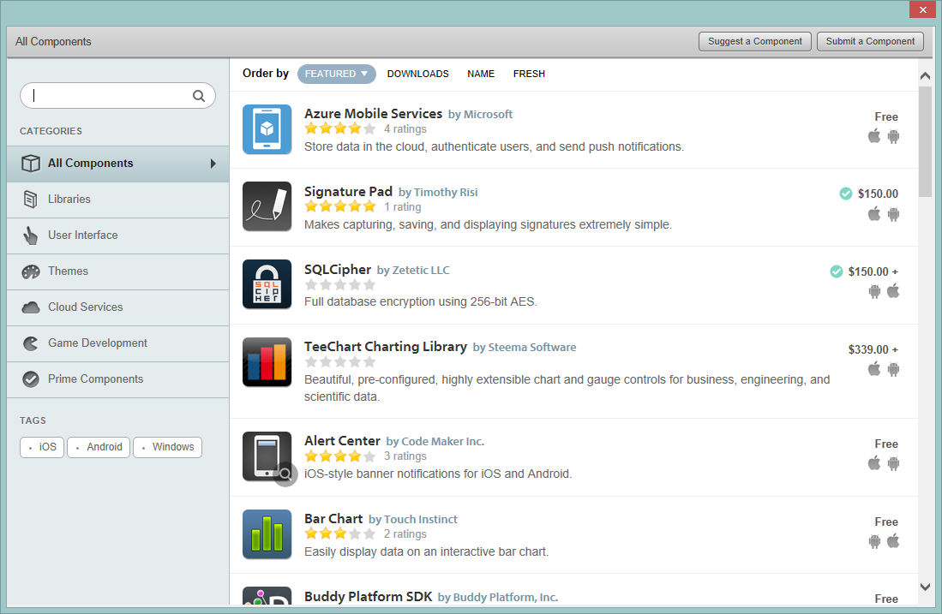
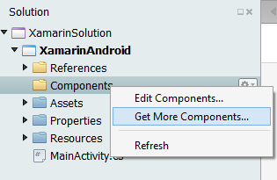
Xamarin Studio & Components
Components also available directly in Xamarin Studio for easy install

Slide 31
The Future
C# 5.0 async/await
F#
iOS User Interface Designer
Xamarin Test Cloud
Even more components
full async programming now available from the core functionality for any platform
support for Microsofts latest functional design language
only available on Mac
Automated test service for Xamarin apps from their cloud system, enabling testing without devices (although always recommended to test on devices before release)
coCos2D announced for 2D, focused on faster iOS support

Slide 32
C# 5.0 async/await
F#
iOS User Interface Designer
Xamarin Test Cloud
Even more components from Xamarin
full async programming now available from the core functionality for any platform
support MS's latest functional design language
only available on Mac
Automated test service for Xamarin apps from their cloud system, enabling testing without devices (although always recommended to test on devices before release)
coCos2D announced for 2D, focused on faster iOS support

Slide 33
Walkthrough

Slide 34
Getting your portable on
Extend
A better way
Think Beyond
Flame on
First project
Getting started
Refactor
Build and run
Prep for another platform
Platform specifics
Portable Class libraries
Portable MonoGame?
Design from the start
Known issues
Time permitting – sneak peak at the SunBurn platform API V2.1 & Engine

Slide 35
Demo 1
Your first project

Slide 36
MonoGame Windows 8
MonoGame Windows Phone
MonoGame iOS
MonoGame Windows
MonoGame Android
Windows Project
Windows Content
Windows 8 Project
Windows 8 Content
Windows Phone Content
Windows Code
Windows 8 Code
Windows Phone Code
Android Project
Android Content
Android Code
iOS Project
iOS Content
iOS Code
Windows Phone Project

Slide 37
The good and the bad
What’s great
What’s not so great
Works great as first project
Clean solution, no clutter
Changes have to be replicated across all solutions
Each project effectively bespoke

Slide 38
Demo 2
Building up with shared code

Slide 39
MonoGame Windows 8
MonoGame Windows Phone
MonoGame iOS
MonoGame Windows
MonoGame Android
Shared Library code
Windows
Windows
8
Windows Phone
Android
iOS
Windows Project
Windows Content
Windows 8 Project
Windows 8 Content
Windows Phone Content
Windows Code
Windows 8 Code
Windows Phone Code
Android Project
Android Content
Android Code
iOS Project
iOS Content
iOS Code
Windows Phone Project

Slide 40
The good and the bad
What’s great
What’s not so great
Single solution
Core code in one place for all platforms
Platform independence kept separate (mostly)
Can become very complicated overtime with more platforms
Code one / test ALL

Slide 41
Demo 3
Working towards best practice

Slide 42
Core Shared code
Platform independent
MonoGame Windows 8
MonoGame Windows Phone
MonoGame iOS
MonoGame Windows
MonoGame Android
Windows Project
Windows Content
Windows 8 Project
Windows 8 Content
Windows Phone Content
Windows Code
Windows 8 Code
Windows Phone Code
Android Project
Android Content
Android Code
iOS Project
iOS Content
iOS Code
Windows Phone Project

Slide 43
The good and the bad
What’s great
What’s not so great
Single code stream, guaranteed to work on al platforms
No mixed code, everything in it’s place
Requires more up front design
Slightly more complicated

Slide 44
Platform Dependencies & Services

Slide 45
PCL
MonoGame iOS
MonoGame Android
MonoGame Windows Project
MonoGame iOS Project
MonoGame Android Project
MonoGame Windows
Component 1 Base
Component 1 Imp
Component 1 Imp
Component 1 Imp

Slide 46
Other info

Slide 47
Wrap up / Q&A

